Slide 1

Module 7.1 – Parallel Computation Patterns (Histogram)
Histogramming

Slide 2
Objective
To learn the parallel histogram computation pattern
An important, useful computation
Very different from all the patterns we have covered so far in terms of output behavior of each thread
A good starting point for understanding output interference in parallel computation
2

Slide 3
Histogram
A method for extracting notable features and patterns from large data sets
Feature extraction for object recognition in images
Fraud detection in credit card transactions
Correlating heavenly object movements in astrophysics
…
Basic histograms - for each element in the data set, use the value to identify a “bin counter” to increment

Slide 4
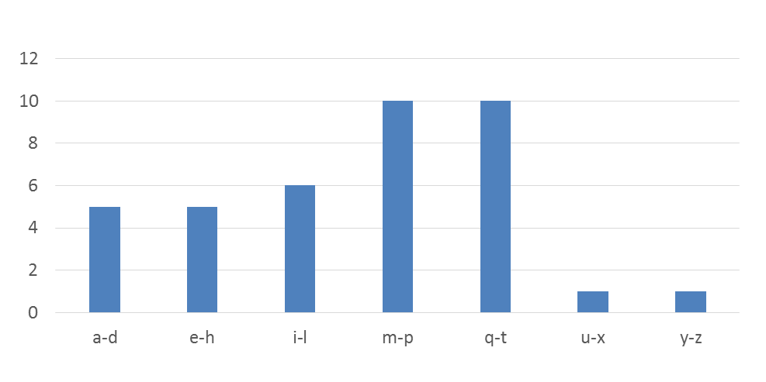
A Text Histogram Example
Define the bins as four-letter sections of the alphabet: a-d, e-h, i-l, n-p, …
For each character in an input string, increment the appropriate bin counter.
In the phrase “Programming Massively Parallel Processors” the output histogram is shown below:

Slide 5
A simple parallel histogram algorithm
Partition the input into sections
Have each thread to take a section of the input
Each thread iterates through its section.
For each letter, increment the appropriate bin counter

Slide 6
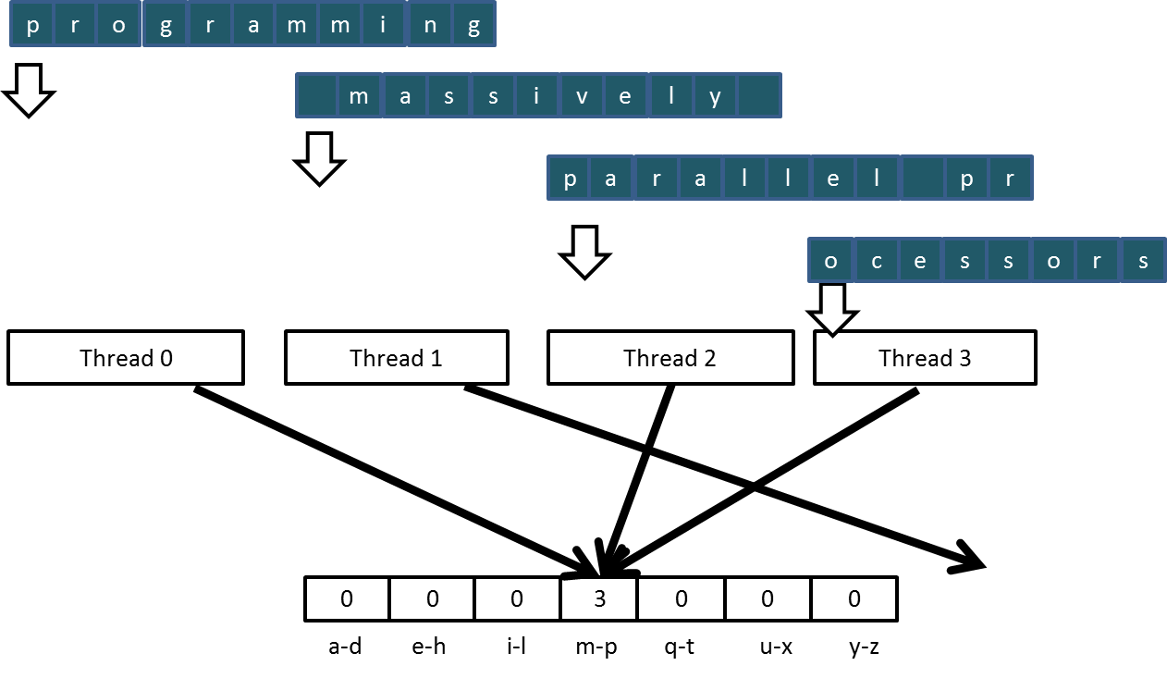
Sectioned Partitioning (Iteration #1)

Slide 7
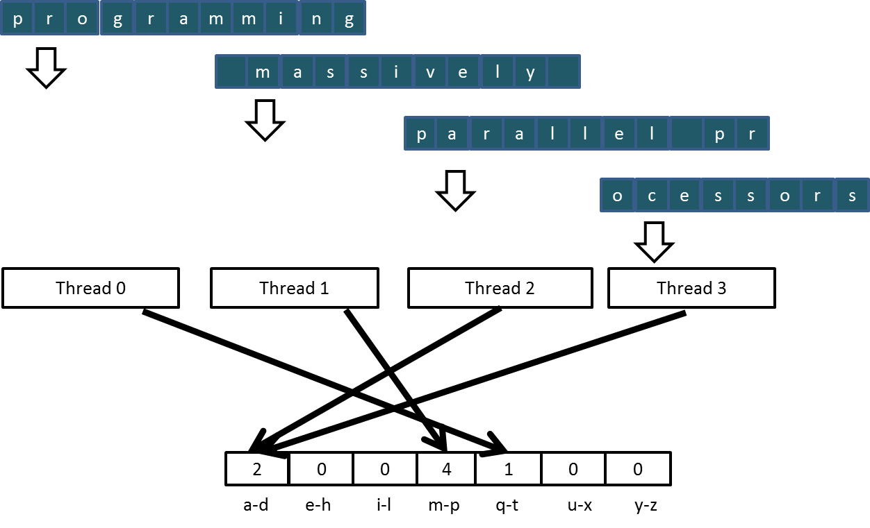
Sectioned Partitioning (Iteration #2)

Slide 8
Input Partitioning Affects Memory Access Efficiency
Sectioned partitioning results in poor memory access efficiency
Adjacent threads do not access adjacent memory locations
Accesses are not coalesced
DRAM bandwidth is poorly utilized

Slide 9
Input Partitioning Affects Memory Access Efficiency
Sectioned partitioning results in poor memory access efficiency
Adjacent threads do not access adjacent memory locations
Accesses are not coalesced
DRAM bandwidth is poorly utilized
Change to interleaved partitioning
All threads process a contiguous section of elements
They all move to the next section and repeat
The memory accesses are coalesced
1
1
1
1
1
2
2
2
2
2
3
3
3
3
3
4
4
4
4
4
1
2
3
4
1
2
3
4
1
2
3
4
1
2
3
4
1
2
3
4

Slide 10
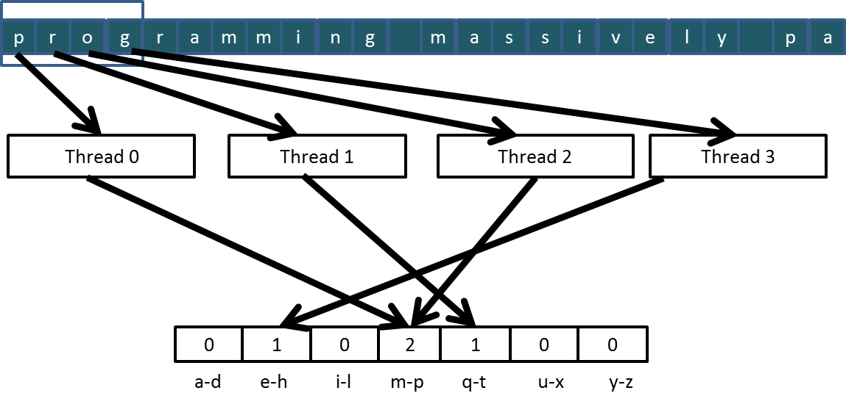
Interleaved Partitioning of Input
For coalescing and better memory access performance
…

Slide 11
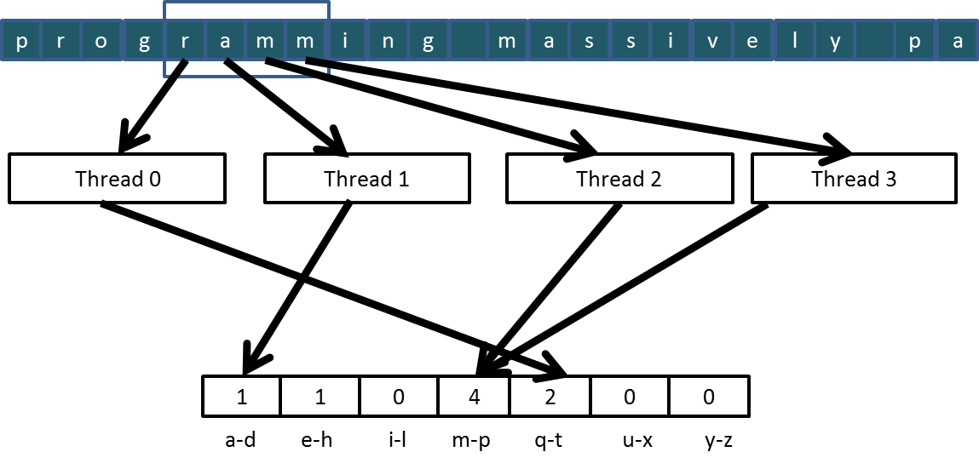
Interleaved Partitioning (Iteration 2)
…

Slide 12
The GPU Teaching Kit is licensed by NVIDIA and the University of Illinois under the Creative Commons Attribution-NonCommercial 4.0 International License.

